Slide 1
473
player
Rusher
Wall-Hugger
Interceptor
The enemy will run into a wall.
Players will earn points.
energy bar

Slide 2
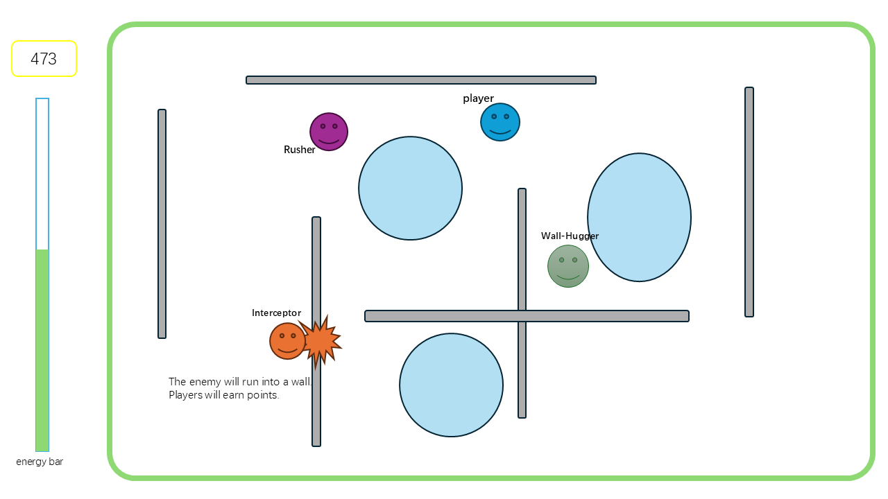
You control a blue man using mouse-driven acceleration to determine your thrust direction, while your left hand toggles the laws of physics. Your goal is not to fight, but to survive an increasingly lethal hunt by manipulating your own inertia.
A-Key (High Friction): "The Grip." Provides instant traction and allows for impossible, sharp-angle turns.
S-Key (Low Friction): "The Drift." Removes resistance, allowing you to build immense speed and slide across the map like a puck on ice.
Spacebar: Resets to standard physics.
The Energy Bar limits your use of friction fields.
Activating High or Low friction drains energy.
Energy regenerates naturally over time
The Triple Threat:
The Hound (Purple): An aggressive pursuit dog.
The Interceptor: A sophisticated predictive bot
The Herder: A tactical man that maintains a perimeter.

